Slide 1

The Rhetoric of Research Objects
researchobject.org
Professor Carole Goble
The University of Manchester, UK
carole.goble@manchester.ac.uk
ISWC2017 SemSci Workshop, Vienna, 21 October 2017
Notes:
We have all grown up with the research article and article collections (let’s call them libraries) as the prime means of scientific discourse. But research output is more than just the rhetorical narrative. The experimental methods, computational codes, data, algorithms, workflows, Standard Operating Procedures, samples and so on are the objects of research that enable reuse and reproduction of scientific experiments, and they too need to be examined and exchanged as research knowledge.
We can think of “Research Objects” as different types and as packages all the components of an investigation. If we stop thinking of publishing papers and start thinking of releasing Research Objects (software), then scholar exchange is a new game: ROs and their content evolve; they are multi-authored and their authorship evolves; they are a mix of virtual and embedded, and so on.
But first, some baby steps before we get carried away with a new vision of scholarly communication. Many journals (e.g. eLife, F1000, Elsevier) are just figuring out how to package together the supplementary materials of a paper. Data catalogues are figuring out how to virtually package multiple datasets scattered across many repositories to keep the integrated experimental context.
Research Objects [1] (http://researchobject.org/) is a framework by which the many, nested and contributed components of research can be packaged together in a systematic way, and their context, provenance and relationships richly described. The brave new world of containerisation provides the containers and Linked Data provides the metadata framework for the container manifest construction and profiles. It’s not just theory, but also in practice with examples in Systems Biology modelling, Bioinformatics computational workflows, and Health Informatics data exchange. I’ll talk about why and how we got here, the framework and examples, and what we need to do.
[1] Sean Bechhofer, Iain Buchan, David De Roure, Paolo Missier, John Ainsworth, Jiten Bhagat, Philip Couch, Don Cruickshank, Mark Delderfield, Ian Dunlop, Matthew Gamble, Danius Michaelides, Stuart Owen, David Newman, Shoaib Sufi, Carole Goble, Why linked data is not enough for scientists, In Future Generation Computer Systems, Volume 29, Issue 2, 2013, Pages 599-611, ISSN 0167-739X, https://doi.org/10.1016/j.future.2011.08.004

Slide 2
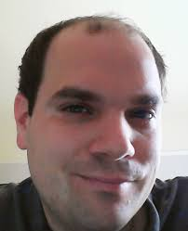
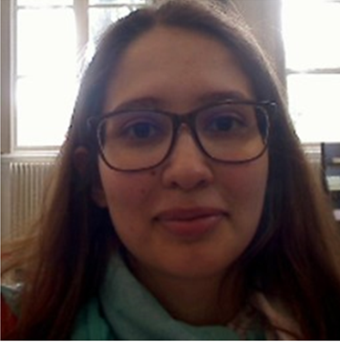
Acknowledgements
Stian Soiland-Reyes
Catarina Martins

Slide 3
Scholarly Communication
Rhetoric
Virtual Witnessing
“The art of discourse, wherein a writer or speaker strives to inform, persuade or motivate particular audiences in specific situations”
papers should describe the results and provide a clear enough method to allow successful repetition and extension
announce a result
convince readers the result is correct
https://en.wikipedia.org/wiki/Rhetoric
Leviathan and the Air-Pump: Hobbes, Boyle, and the Experimental Life (1985) Shapin and Schaffer.
Accessible Reproducible Research, Science 22 January 2010, Vol. 327 no. 5964 pp. 415-416, DOI: 10.1126/science.1179653
Notes:
Analogy
Emotional appeal

Slide 4
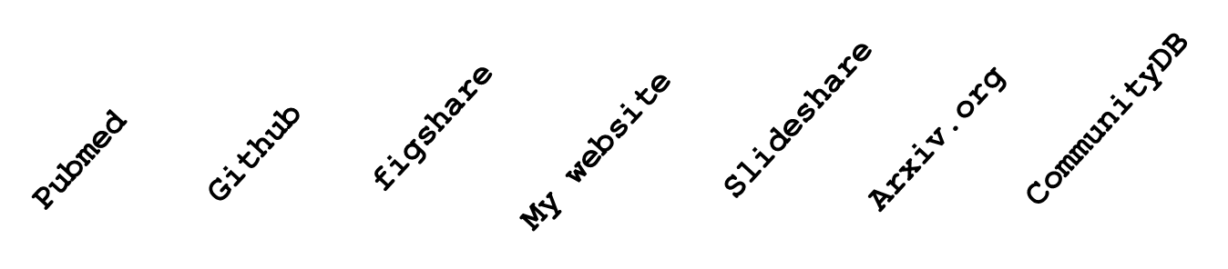
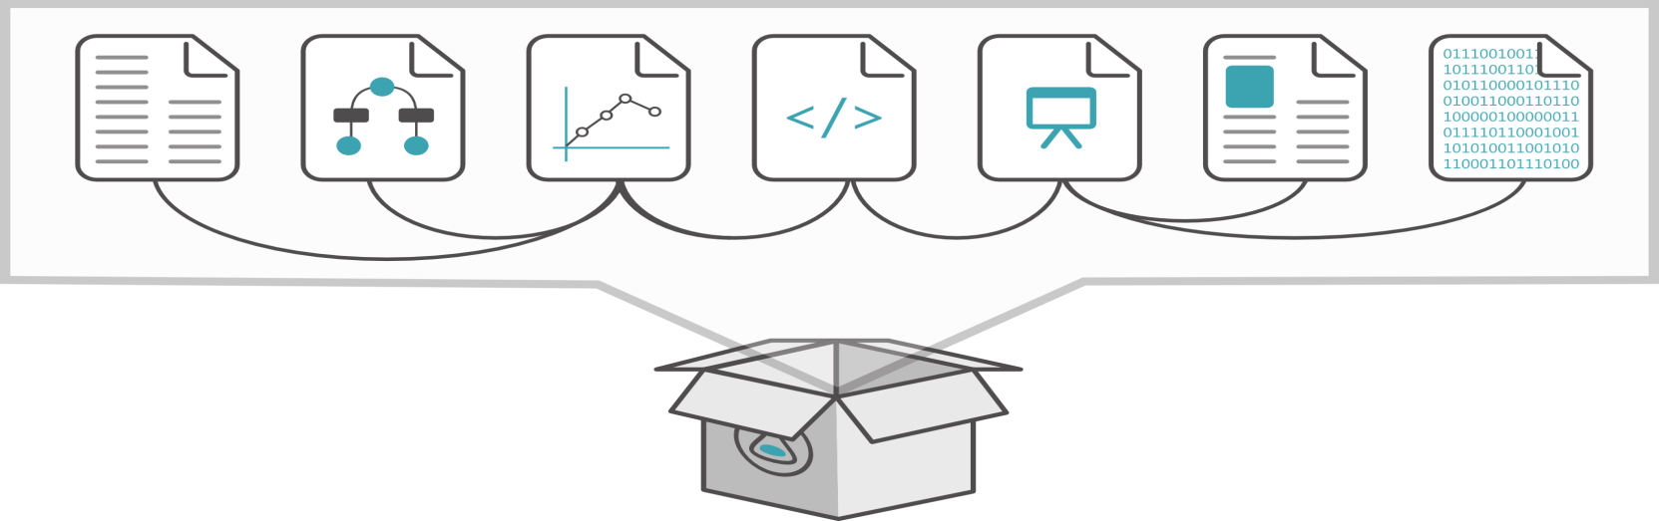
From Manuscripts to Research Objects
“An article about computational science in a scientific publication is not the scholarship itself, it is merely advertising of the scholarship. The actual scholarship is the complete software development environment, [the complete data] and the complete set of instructions which generated the figures.” David Donoho, “Wavelab and Reproducible Research,” 1995
Datasets, Data collections
Standard operating procedures
Software, algorithms
Configurations,
Tools and apps, services
Codes, code libraries
Workflows, scripts
System software
Infrastructure
Compilers, hardware

Slide 5
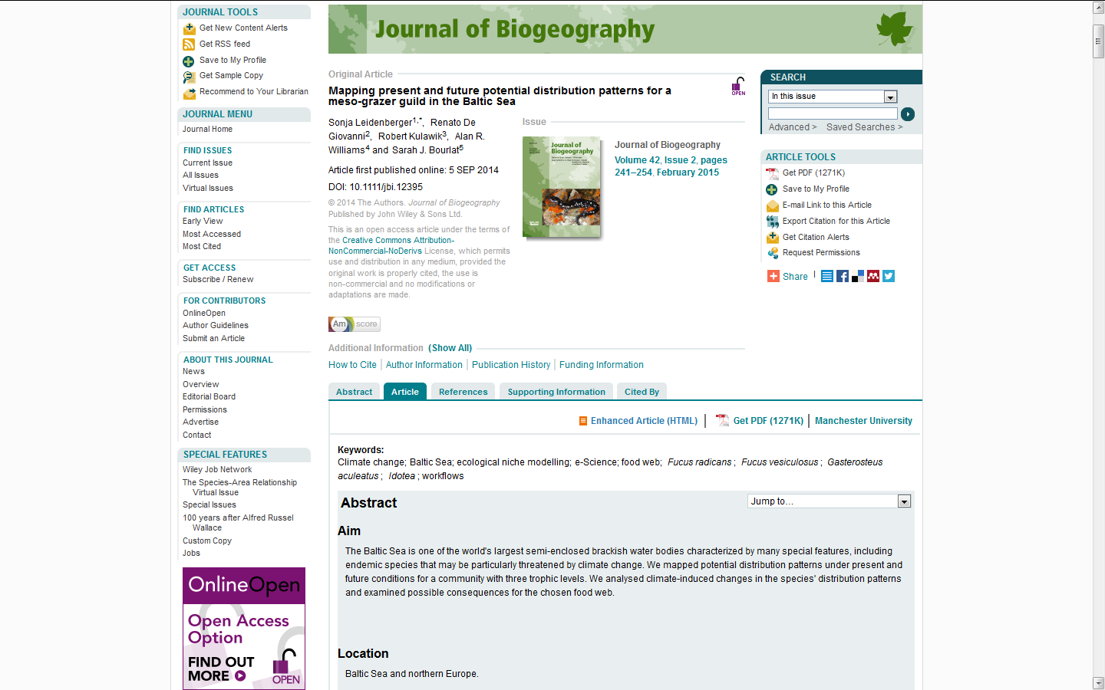
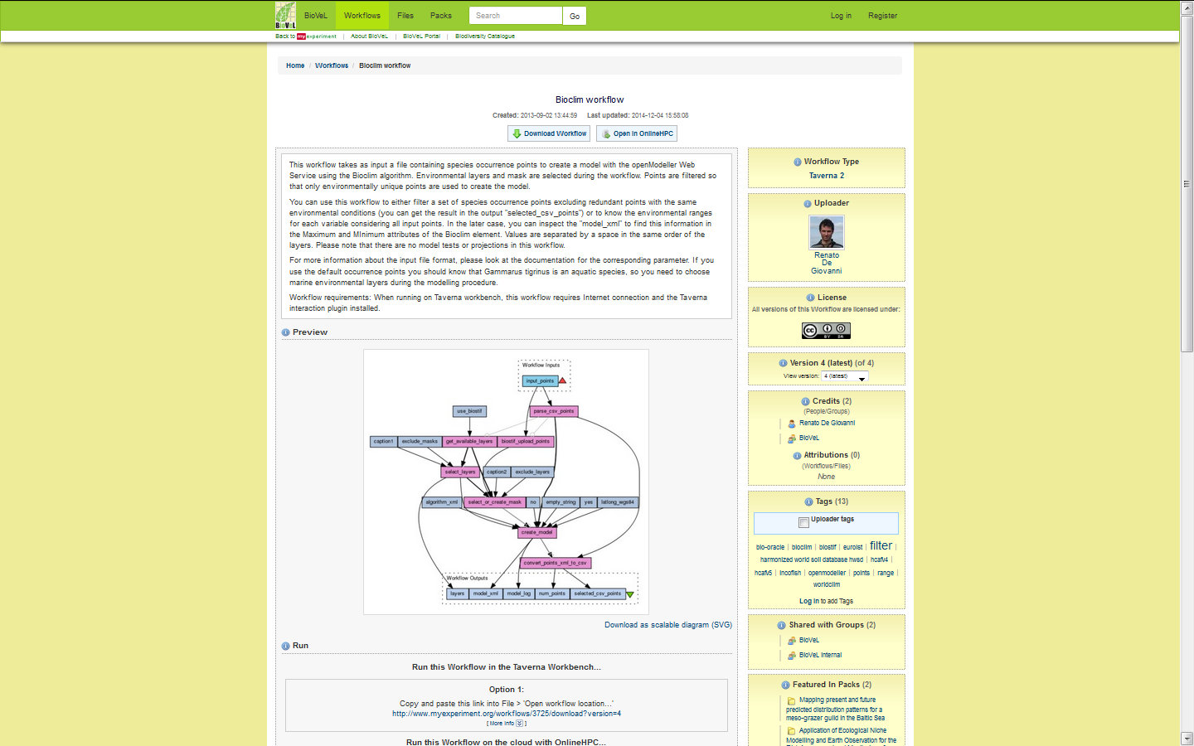
Research Components in a study and backing an article are Many and Various

Slide 6
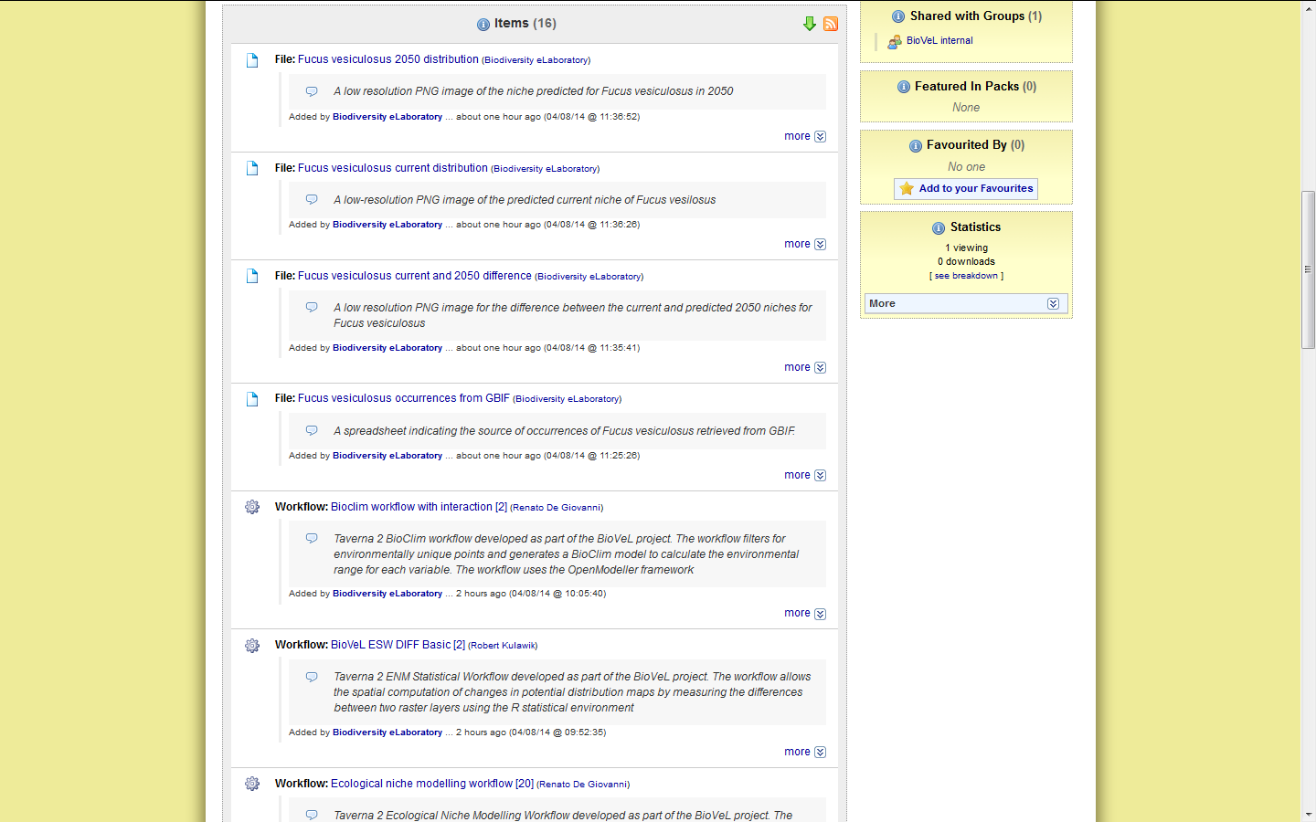
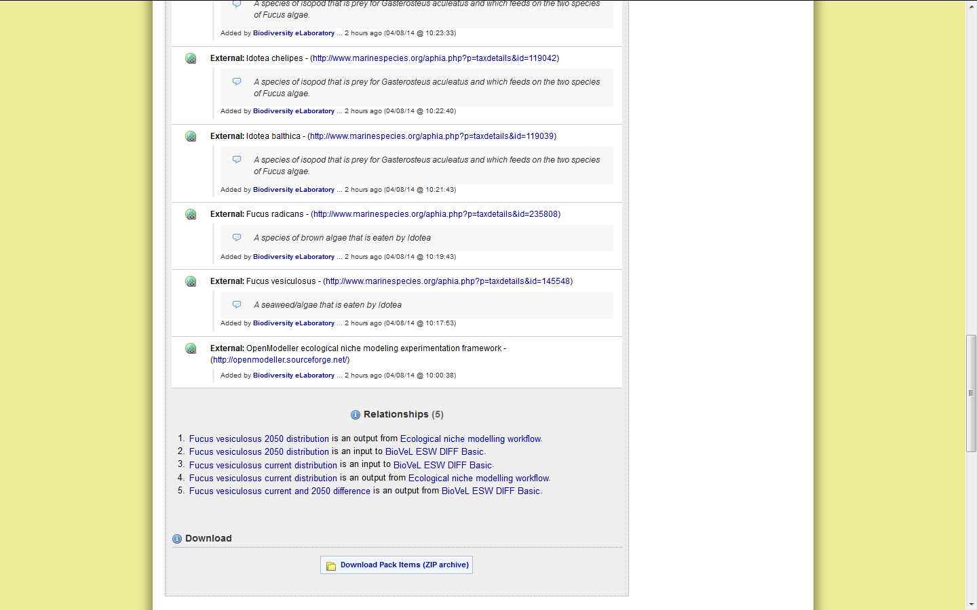

workflow commons

Slide 7
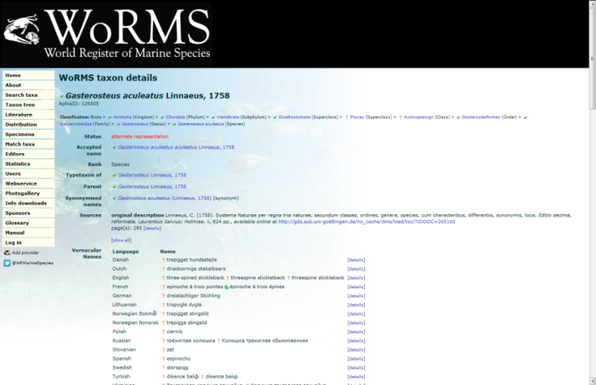

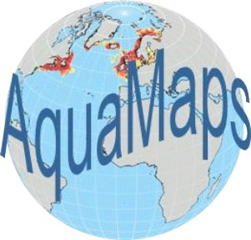

Collection in a Data Catalogue
Third party remote web services or command line tools
Workflows of local or remotely executed codes

Slide 8
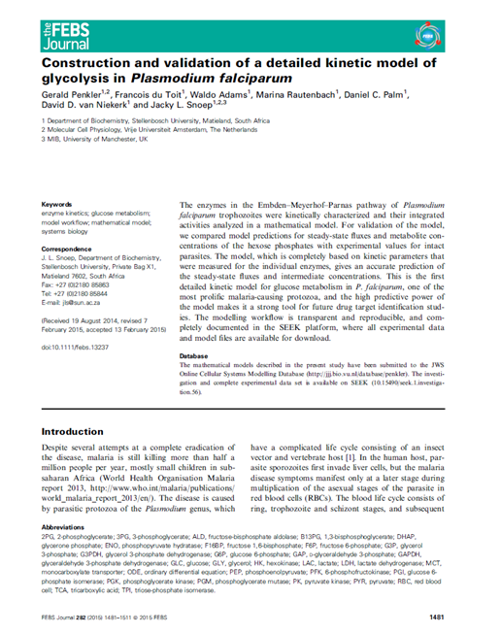






Research Components in a study and backing an article are Many and Various
16 datafiles (kinetic, flux inhibition, runout)
19 models (kinetics, validation)
13 SOPs
3 studies (model analysis, construction, validation)
Penkler, G., du Toit, F., Adams, W., Rautenbach, M., Palm, D. C., van Niekerk, D. D. and Snoep, J. L. (2015), Construction and validation of a detailed kinetic model of glycolysis in Plasmodium falciparum. FEBS J, 282: 1481–1511. doi:10.1111/febs.13237
24 assays/analyses (simulations, model characterisations)

Slide 9
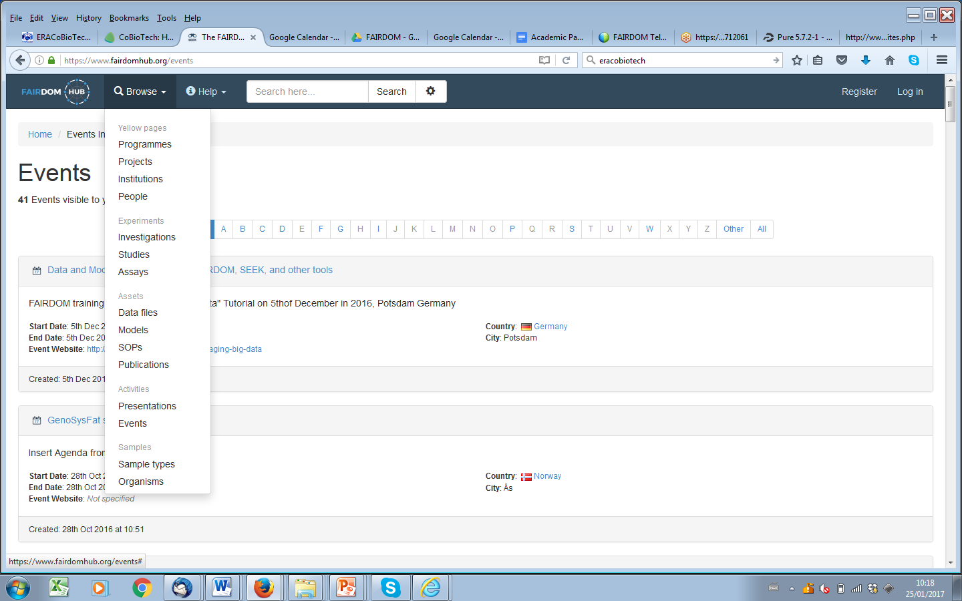
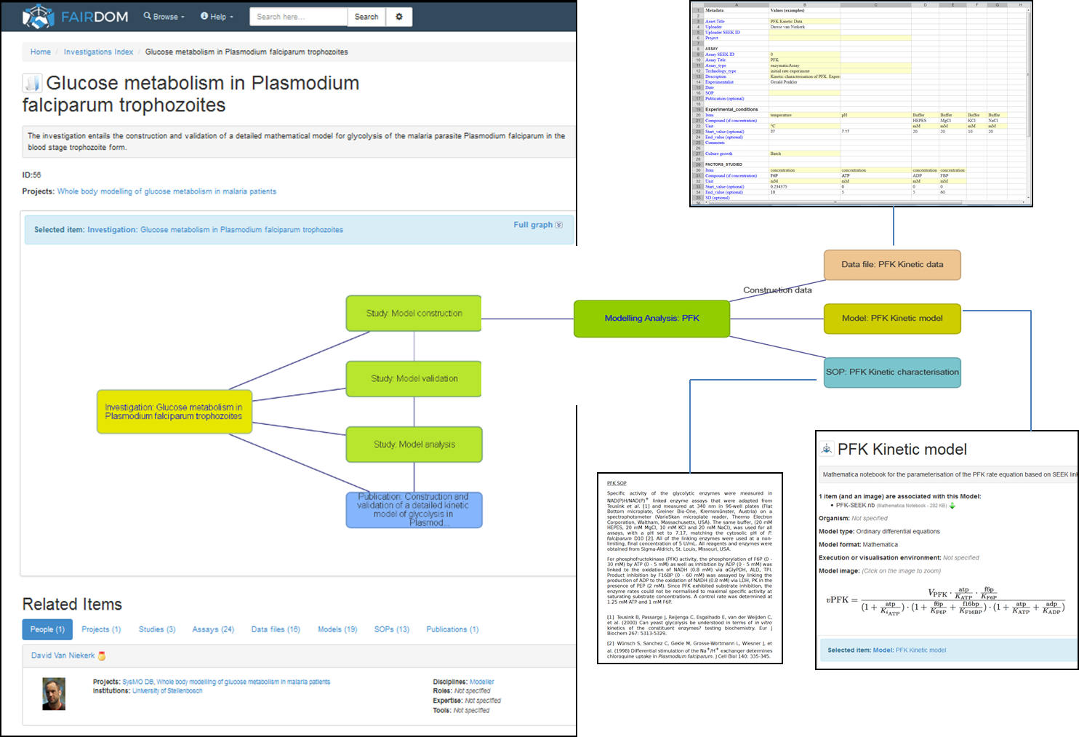
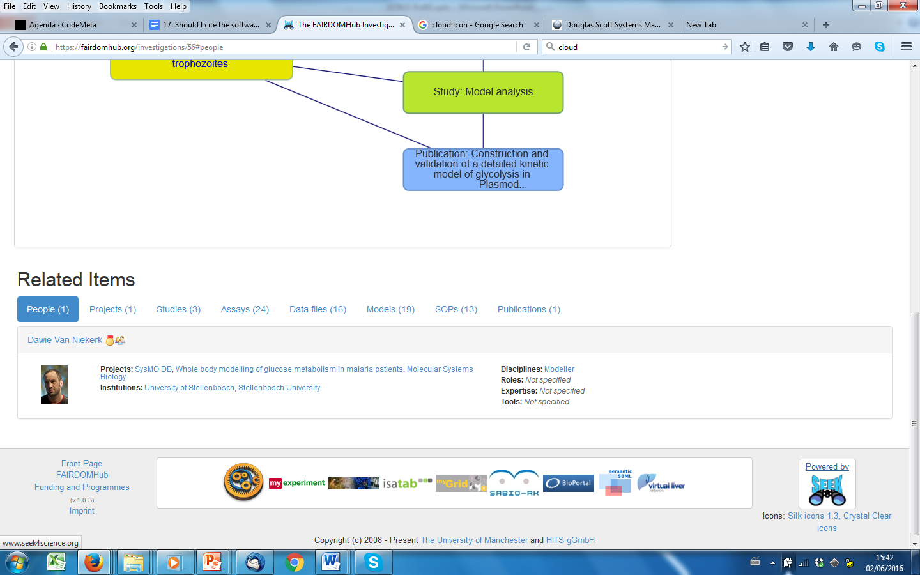

Systems Biology Commons
Data
Study
Analysis
Model
(Assay)
SOP
Investigation
https://fairdomhub.org/investigations/56
Notes:
Linking, “Packaging” & Citing Codes, Data, Models, SOPs, Samples, Strains, Articles, People, Projects, ELNs….

Slide 10

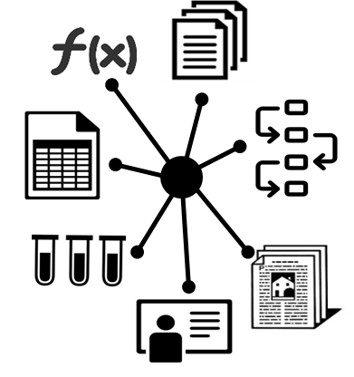




Multi-results & Versions
Data of many types…
Primary, secondary, tertiary…
Methods, models, scripts …
Spans repository silos
Regardless of location
In house….
External - subject specific, general
Structured organisation
Retaining context
over fragmentation
Notes:
Impacts on metadata and on transfer and access

Slide 11
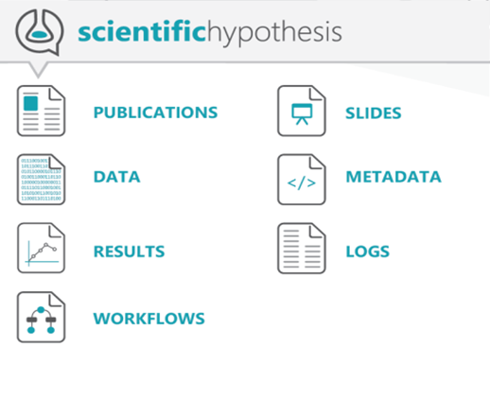
A Research Object bundles and relates digital resources of a scientific experiment/investigation + context
Data used and results produced in experimental study​
Methods employed to produce and analyse that data​
Provenance and settings for the experiments​
People involved in the investigation​
Annotations about these resources, to improve understanding and interpretation

Slide 12
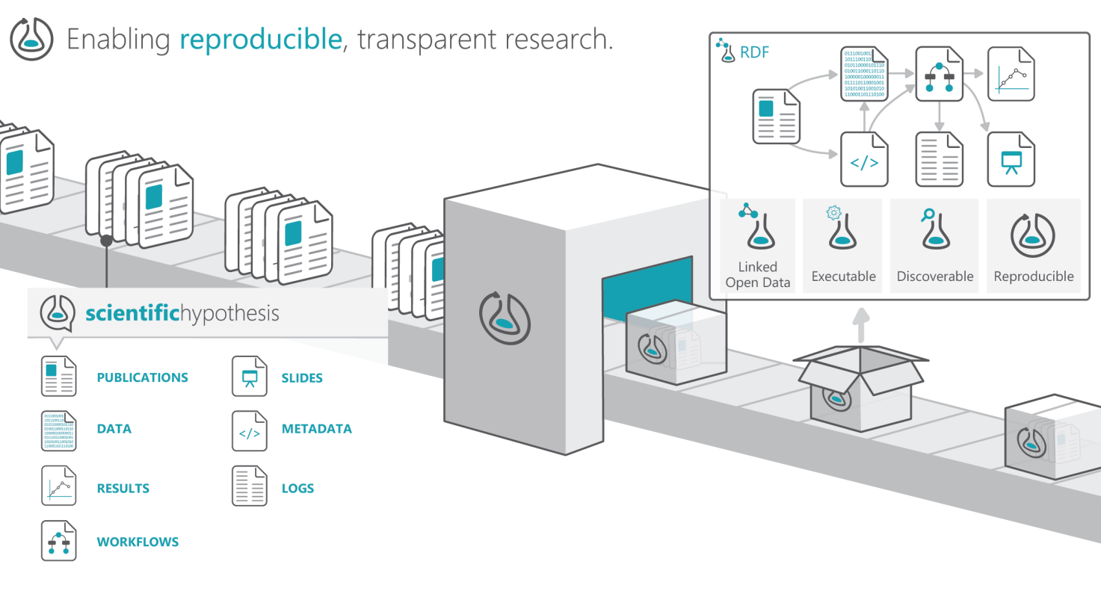
researchobject.org
Standards-based metadata framework for bundling embedded and referenced resources with context
Citable Reproducible Packaging

Slide 13
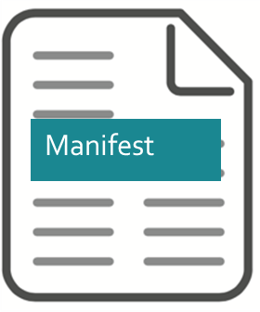


Research Object
in a nutshell
Rhetorical Analogy 1
Container
Platforms
FAIRDOM, myExperiment
Packaging Frameworks
Zip Archives, BagIt, Docker images
Notes:
ROs combine containers and incremental metadata

Slide 14
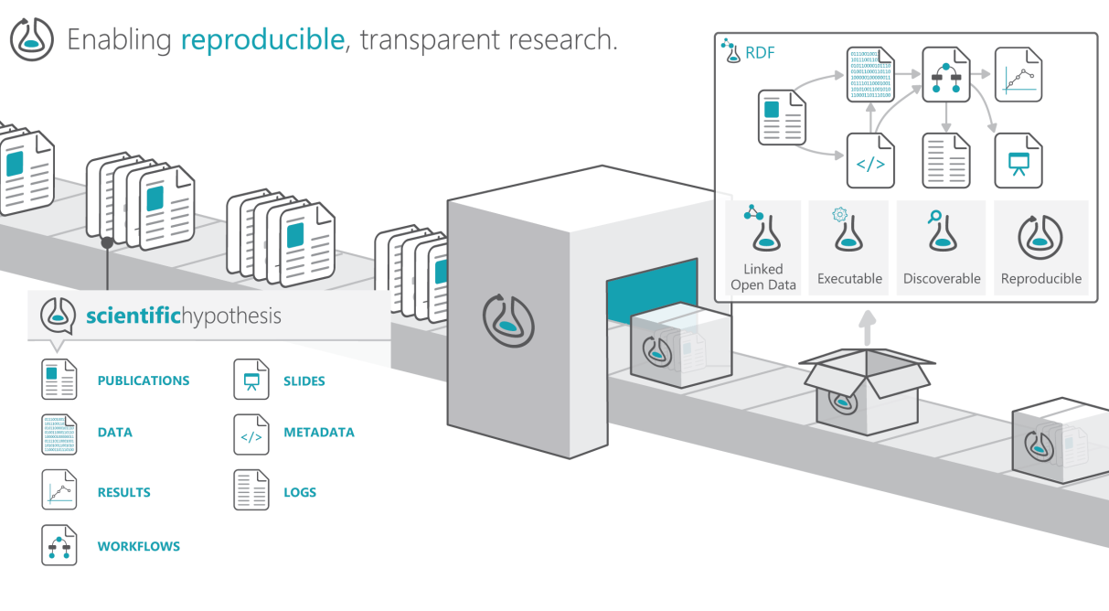
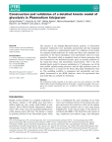
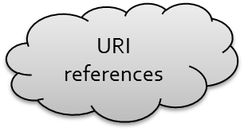
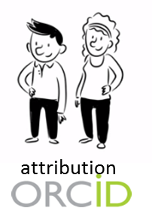



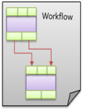
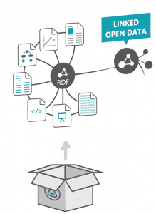

Systems Biology Research Objects exchange, portability and maintenance
checksum
ISA-TAB
components packaged into various containers
Notes:
Mimetype: robundle+zip
ZIP or BagIt folder structure
JSON and YAML
Linked-ISA

Slide 15

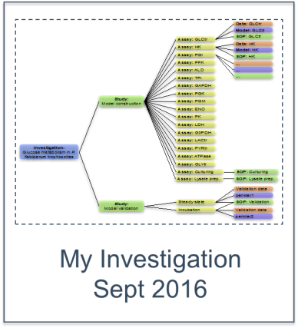
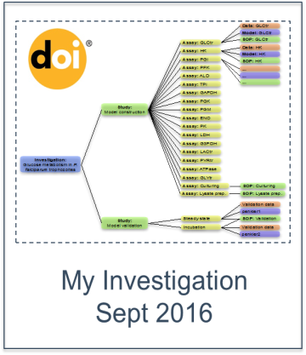




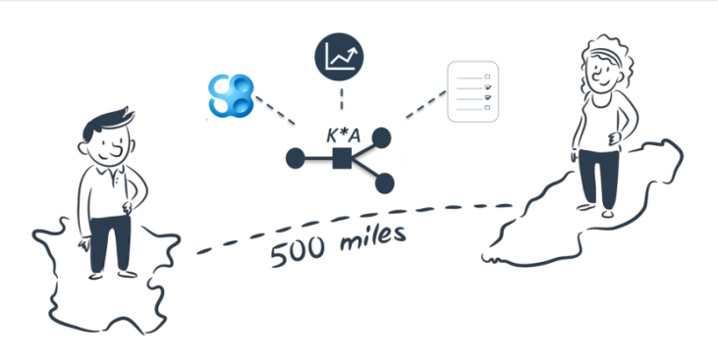

RO Commons and Currency
Author List: Joe Bloggs; Jane Doe
Title: My Investigation
Date: September 2016
DOI: https://doi.org/10.15490/seek##
Version
https://doi.org/10.15490/seek.1.investigation.56
Active entry evolves
information travels with the data and models

Slide 16




Rhetorical Analogies ….
Exchange
Reproducibility
Preservation
Release
Interpretation, Comparison
Portability, Reuse
Credit, Citation
Interpretation, Comparison
Preservation, Repair
Portability, Reuse
Execution
Active Research
Evolving codes
New data
FAIR Commons
Currency of
Scholarship
Scientific Instruments
Machines
Software Release
Executable Papers
Goble, De Roure, Bechhofer, Accelerating Knowledge Turns, DOI: 10.1007/978-3-642-37186-8_1
Notes:
By reference

Slide 17
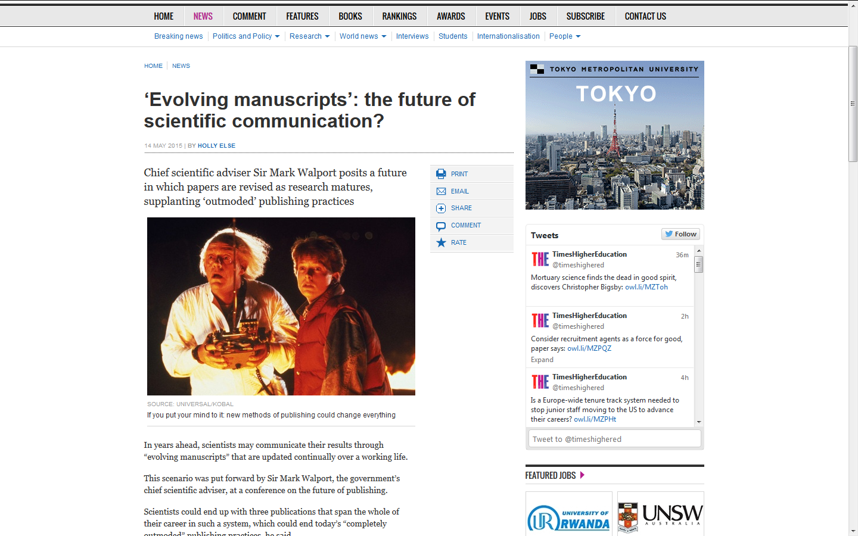
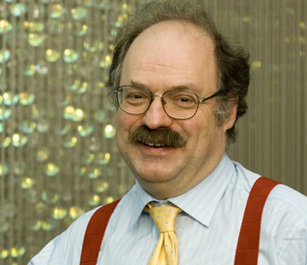

An “evolving manuscript” would begin with a pre-publication, pre-peer review “beta 0.9” version of an article, followed by the approved published article itself, [ … ] “version 1.0”.
Subsequently, scientists would update this paper with details of further work as the area of research develops. Versions 2.0 and 3.0 might allow for the “accretion of confirmation [and] reputation”.
Ottoline Leyser […] assessment criteria in science revolve around the individual. “People have stopped thinking about the scientific enterprise”.
Release
http://www.timeshighereducation.co.uk/news/evolving-manuscripts-the-future-of-scientific-communication/2020200.article
Notes:
Release like software
http://www.timeshighereducation.co.uk/news/evolving-manuscripts-the-future-of-scientific-communication/2020200.article
Evolving manuscripts’: the future of scientific communication?
14 May 2015 | By Holly Else
Chief scientific adviser Sir Mark Walport posits a future in which papers are revised as research matures, supplanting ‘outmoded’ publishing practices
Source: Universal/Kobal
If you put your mind to it: new methods of publishing could change everything
In years ahead, scientists may communicate their results through “evolving manuscripts” that are updated continually over a working life.
This scenario was put forward by Sir Mark Walport, the government’s chief scientific adviser, at a conference on the future of publishing.
Scientists could end up with three publications that span the whole of their career in such a system, which could end today’s “completely outmoded” publishing practices, he said.
Sir Mark was speaking at the second part of the Royal Society’s Future of Scholarly Scientific Communication conference, held in London on 5-6 May.
His idea would help to mitigate “perverse incentives” in the current system, he said. These include a bias against publishing negative results or those that confirm or confound existing research, as well as the pressures that scientists face to split a piece of work into multiple articles.
“We must facilitate new ways of publication…We have hardly scratched the surface of the potential of new publishing models to communicate science in much better ways than we have been doing,” he said.
An “evolving manuscript” would begin with a pre-publication, pre-peer review “beta 0.9” version of an article, followed by the approved published article itself, which Sir Mark dubs “version 1.0”.
Subsequently, scientists would update this paper with details of further work as the area of research develops. Versions 2.0 and 3.0 might allow for the “accretion of confirmation [and] reputation”, for example.
“The idea that you start from scratch with every [new] paper and you publish a bit of new data [so that] you slightly change the discussion is a completely outmoded way of doing science in the 21st century,” Sir Mark added.
“One could have a much more organic publication that would include the repeats of the work that would publish automatically alongside it,” he explained.
There would need to be a system to “Kitemark” an evolving manuscript and highlight the most up-to-date version, he said. A “golden thread” linking the body of work would also be necessary. “The thread would need to be rewritten on a continual basis,” he added.
“We could be in a world where you write three papers in your entire life, and they just evolve,” he said.
Sir Mark added that the system might encourage more debate among scientists about research after work has been published. Post-publication peer review so far has an “abysmal” record among scientists, he said.
There is an “issue with the culture of science” that means researchers are “pretty good” at criticising each other at meetings and conferences but are “very, very bad” at being willing to criticise each other in post-publication peer review, he said.
Ottoline Leyser, director of the Sainsbury Laboratory at the University of Cambridge, said this might be because at the moment the assessment criteria in science revolve around the individual. “People have stopped thinking about the scientific enterprise,” she said.
“If someone criticises your work, that is a jolly good thing; and if it turns out you are wrong, that is excellent because then you have disproved your hypothesis and can move forward,” she added.
Such issues are “fundamental to the philosophy of science” and to research progress. But they are now “associated with negative impact on people’s careers”, she explained.
holly.else@tesglobal.com

Slide 18
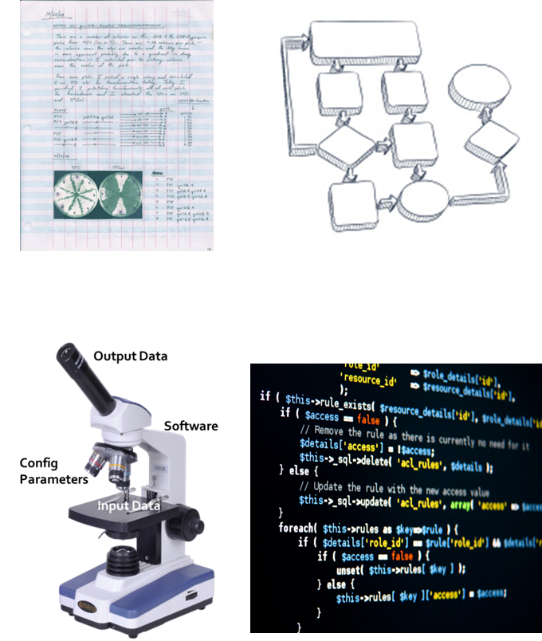
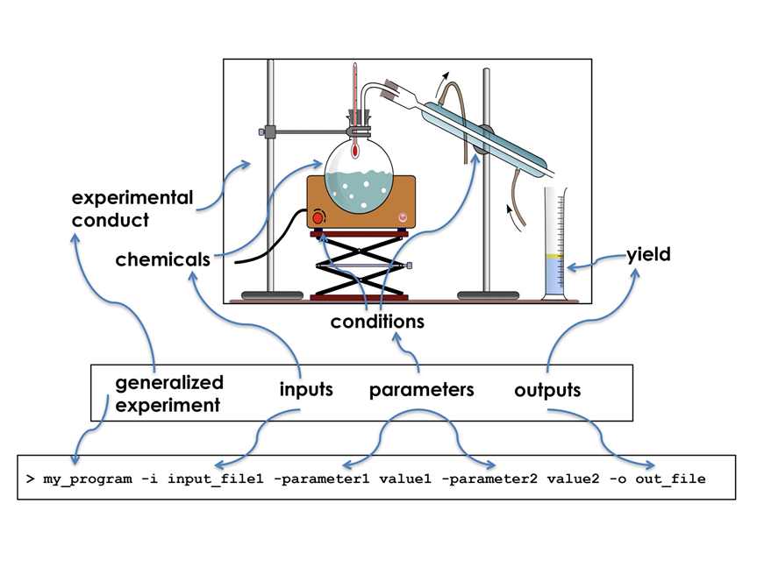
Instrument Analogy
Report
Experiment
Materials
datasets, parameters, thresholds, versions, algorithm seeds
Methods
techniques, algorithms, spec. of the steps, models, versions, robustness
Run
Instruments (by reference)
tools, codes, services, scripts, underlying libraries, versions, workflows, reference datasets
Laboratory
Setup
computational environment, versions

Slide 19

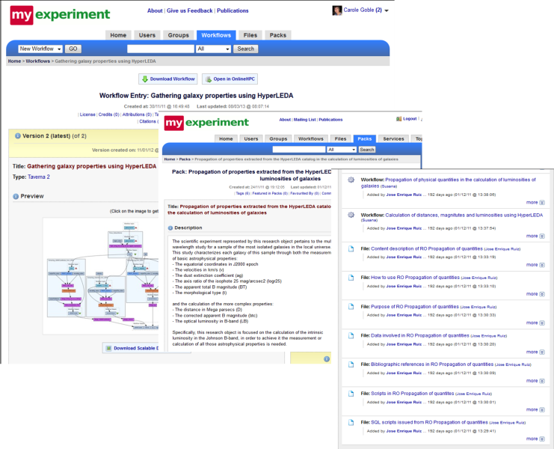
Instrument Analogy
Instruments Break
Technologies, materials and methods change
Scope of use, robustness
Blackboxes –dark and complicated
Workflow
preservation & repair
Notes:
Replace with a workflow?
Fixivity - Liveness
New/updated/deprecated methods, datasets, services, codes, h/w
Snapshots
Dependency – Containment
Streams, non-portable data/software, 3rd party services, supercomputer access, licensing restrictions….
Locally contained and maintained
External dependencies
Transparency
Blackboxes, proprietary software, manual steps
Robustness
Bounds of use
Stochastics, non-deterministics, contexts

Slide 20



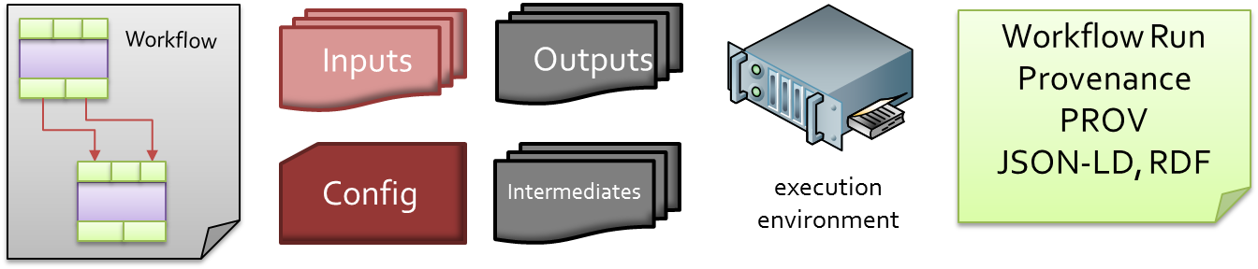









Reports + Machines : Workflow Research Objects
tools
EDAM
Narrative
workflow engine
Linked Data
JSON-LD
RDF
Inputs
Outputs
Checksum
Parameters
Configs
Workflow Run
Provenance
Intermediates
Errors
Community
ontologies & formats
W3C PROV
Provenance Templates
Trajectory mapping
Belhajjame et al (2015) Using a suite of ontologies for preserving workflow-centric research objects,
J Web Semantics doi:10.1016/j.websem.2015.01.003
Hettne KM, et al (2014), Structuring research methods and data with the research object model: genomics workflows as a case study. J. Biomedical Semantics 5: 41
Notes:
Like BCO domains

Slide 21


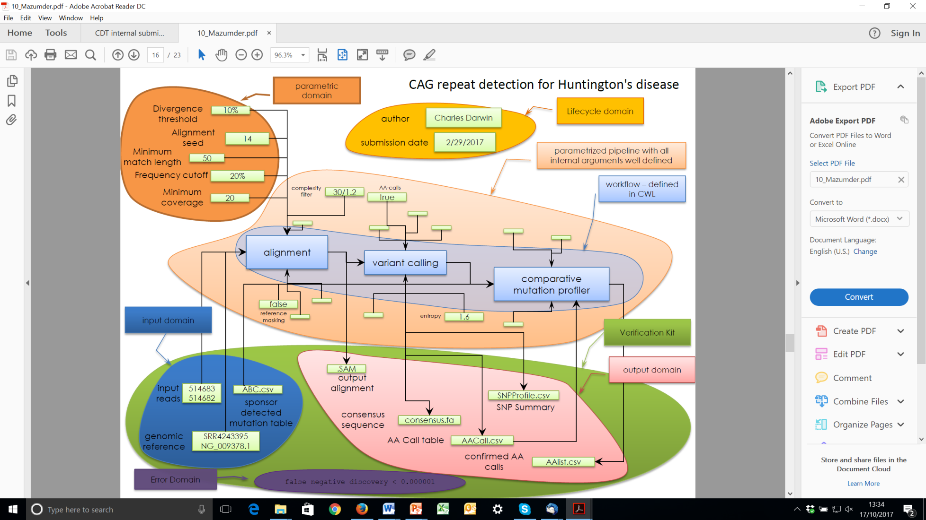




BioCompute Objects
Precision Medicine
NGS workflow exchange, FDA regulatory review submissions.
Emphasis on the parametric domain and robust, safe reuse.
Linked Data, JSON-LD, Ontologies (EDAM, SWO)
Alterovitz, Dean II, Goble, Crusoe, Soiland-Reyes e t al Enabling Precision Medicine via standard communication of NGS provenance, analysis, and results, biorxiv.org, 2017, https://doi.org/10.1101/191783
Notes:
Come back to this later.
Fast Healthcare Interoperability Resources (FHIR, pronounced "fire") is a draft standard describing data formats and elements (known as "resources") and an application programming interface (API) for exchanging electronic health records. The standard was created by the Health Level Seven International (HL7) health-care standards
Enabling Precision Medicine via standard communication of NGS provenance, analysis, and results
doi: https://doi.org/10.1101/191783

Slide 22
How do we build manifests?
Rich, self-describing semantic descriptions about resources and their relationships…..

Slide 23

Research Objects = Metadata Objects
Manifest
Construction
Manifest Description
Type Checklists
what should be there
Provenance
where it came from
Versioning
its evolution
Dependencies
what else is needed
Identification
to locate things
Aggregates
to link things together
Annotations
about things & their relationships
Manifest
Manifest
Container
Notes:
ROs combine containers and incremental metadata
Like DataONE Packages
Its all about the metadata

Slide 24






Containers are Many and Various
pre-packaged Docker images containing a bioinformatics tool and standardised interface through which data and parameters are passed.
repository of >2700 bioinformatics packages ready to use with conda install
Old Favourites
Zip Archives
ePUB Open Container Format (OCF)
Adobe Universal Container Format (UCF)
BagIt Archives
Notes:
And many other solutions….
http://bioboxes.org

Slide 25
Manifest Construction
Manifest
Identification
to locate things
Aggregates
to link things together
Annotations
about things & their relationships
all resources, including external resources and outside references.
attribution and provenance of each resource, for credit and right versions.
any part of the RO to be further described textually or semantically
extensibility point for community-driven standards
Structured ZIP-file
based on ePub (OCF) & Adobe UCF specifications
Notes:
https://www.w3.org/TR/annotation-vocab/

Slide 26
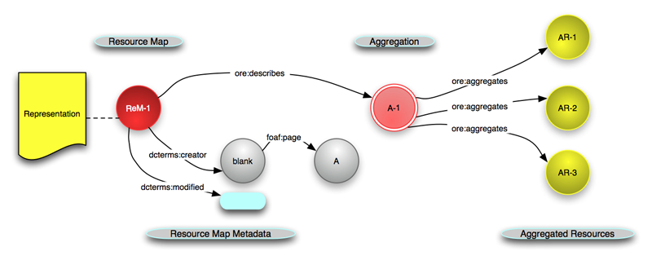
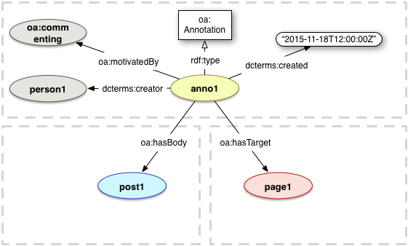
Manifest Construction
Manifest
Identification
to locate things
Aggregates
to link things together
Annotations
about things & their relationships
RRI, DOI, URI, ORCID
Open Archives Initiative Object Exchange and Reuse
W3C Web Annotation Vocabulary
Structured ZIP-file
based on ePub (OCF) & Adobe UCF specifications

Slide 27
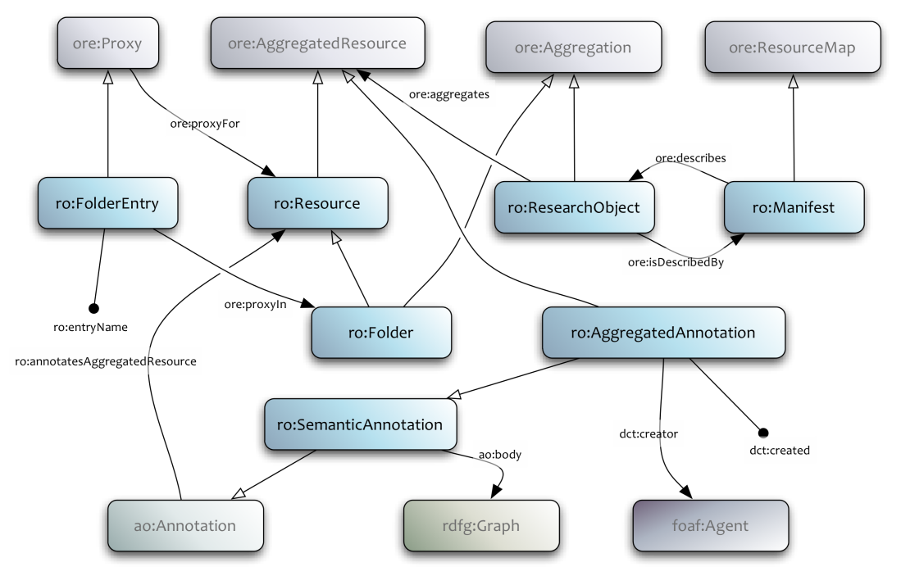
Manifest Construction
Manifest
Identification
to locate and resolve things
Aggregates
to link things together
Annotations
about things & their relationships
RRI,
DOI, URI, ORCID
Open Archives Initiative Object Exchange and Reuse
W3C Web Annotation Vocabulary
http://www.researchobject.org/specifications/
Structured ZIP-file
based on ePub (OCF) & Adobe UCF specifications

Slide 28
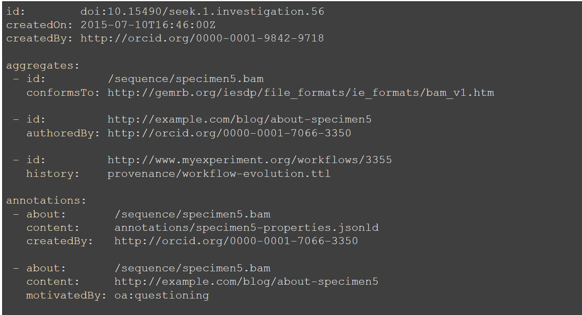
Artists Impression

Slide 29
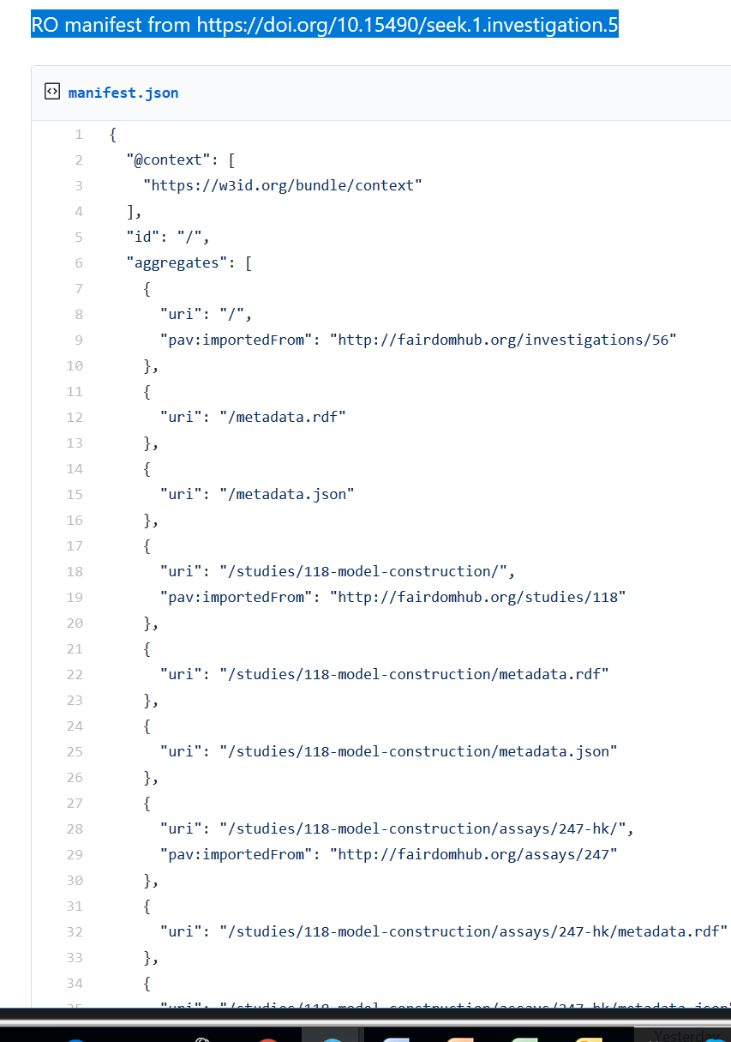
The real manifest
A Manifest
for 27 A4 pages ….
RO manifest from FAIRDOM
https://doi.org/10.15490/seek.1.investigation.5
Notes:
JERM and DC Terms and so on in those nested metadata.rdf files - one per SEEK resource that is part of the investigation

Slide 30
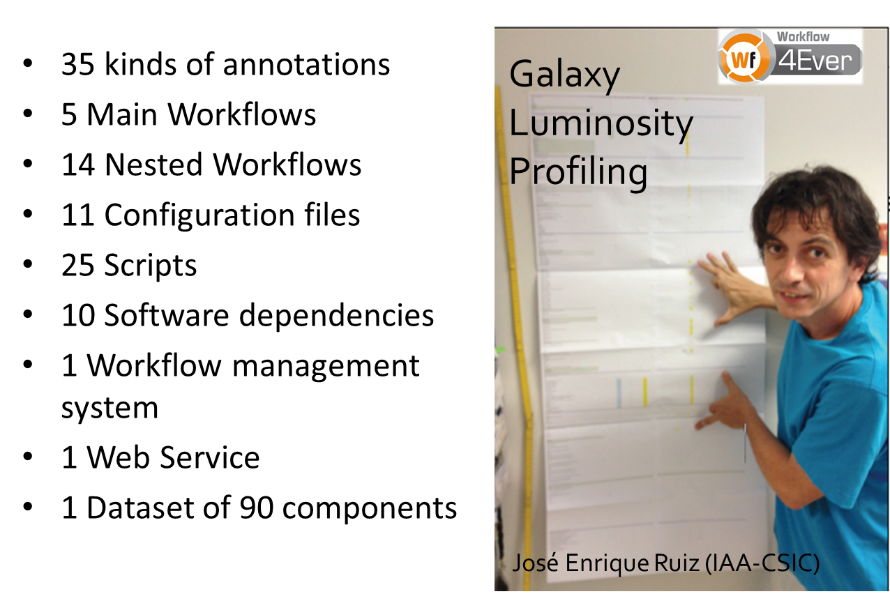

The need for embedded tools

Slide 31
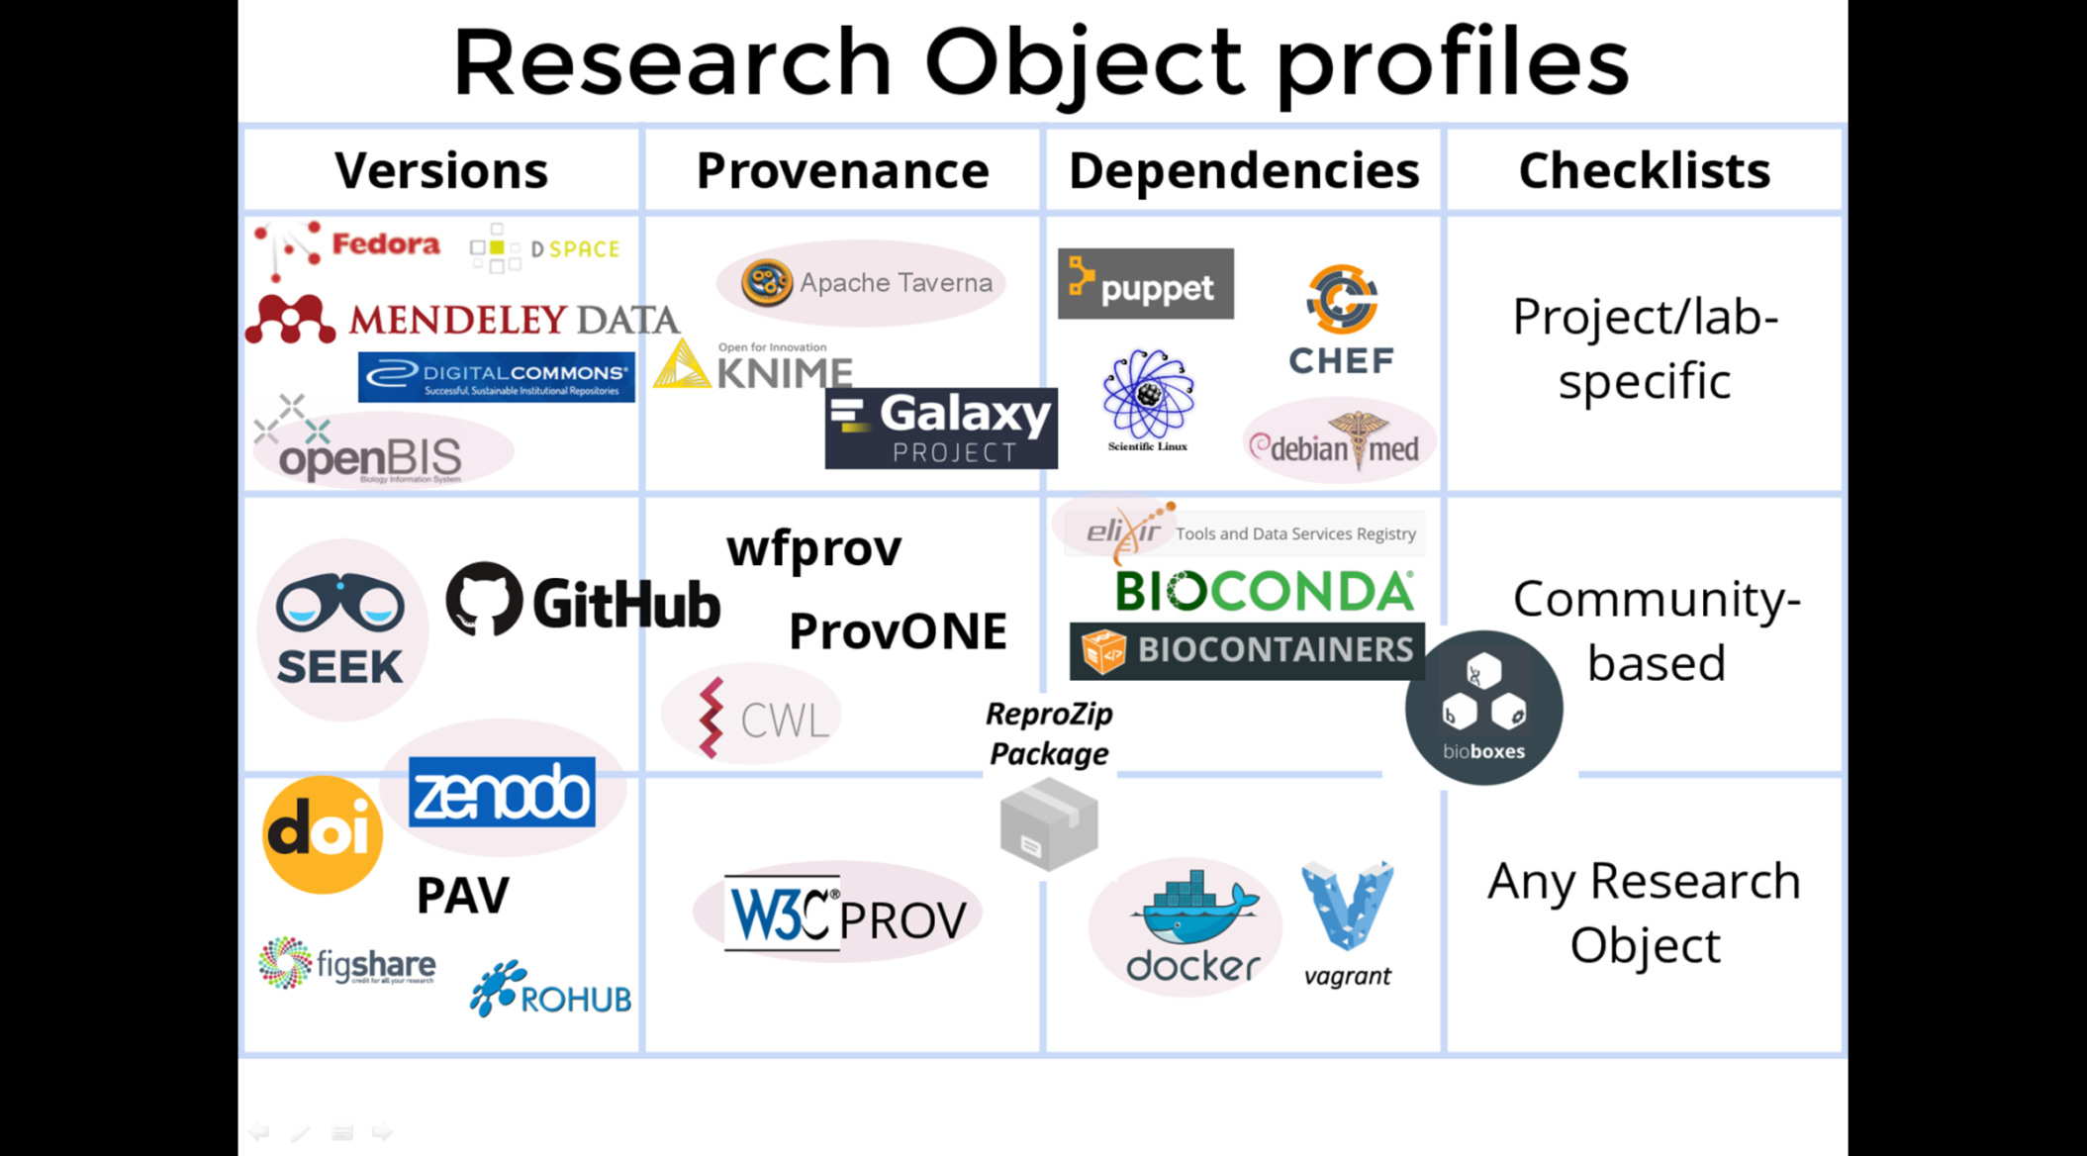













Manifest Description: Profiles
Manifest
where it came from
what else
is needed
what should be there for types
its evolution
Project / Lab
Specific
Community- based Types
Context
All
VoID
Notes:
Checklist checks what annotations should be there
Some will be word docs
Some will RDF Graphs extracted from, say CWL,
“there has to be a CWL file”
Turtles all the way down
Currently CWL in a RO (with the files)
A CWL RO has the parts exposed.
Version and provenance in the RO model
Checklists in the annotations

Slide 32


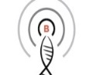



















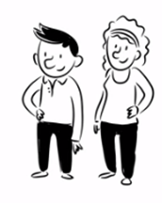
Trend: JSON(-LD) + Schemas
Manifest
schema.org tailored to the Biosciences
Standardised metadata
mark-up
Data
repository
Training
Resource
Data
repository
Bioschemas
Bioschemas
Bioschemas
Metadata published and harvested without APIs or special feeds
Search engines
Registries
Data
Aggregators
OmicsDI
BBMRI-ERIC Directory
Commodity
Off the Shelf tools
App eco-system
Lightweight
Sample Catalogue

Slide 33
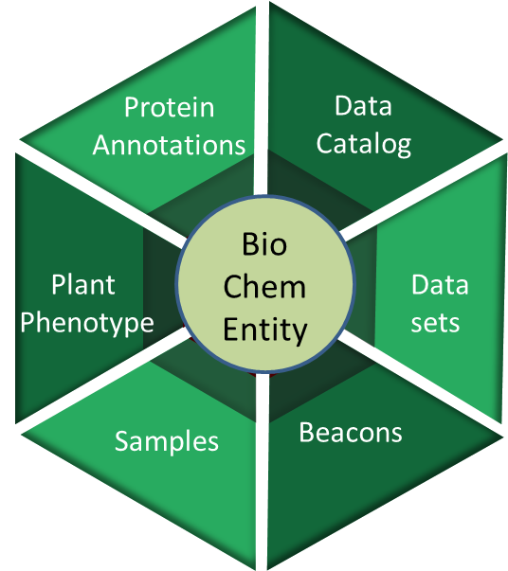
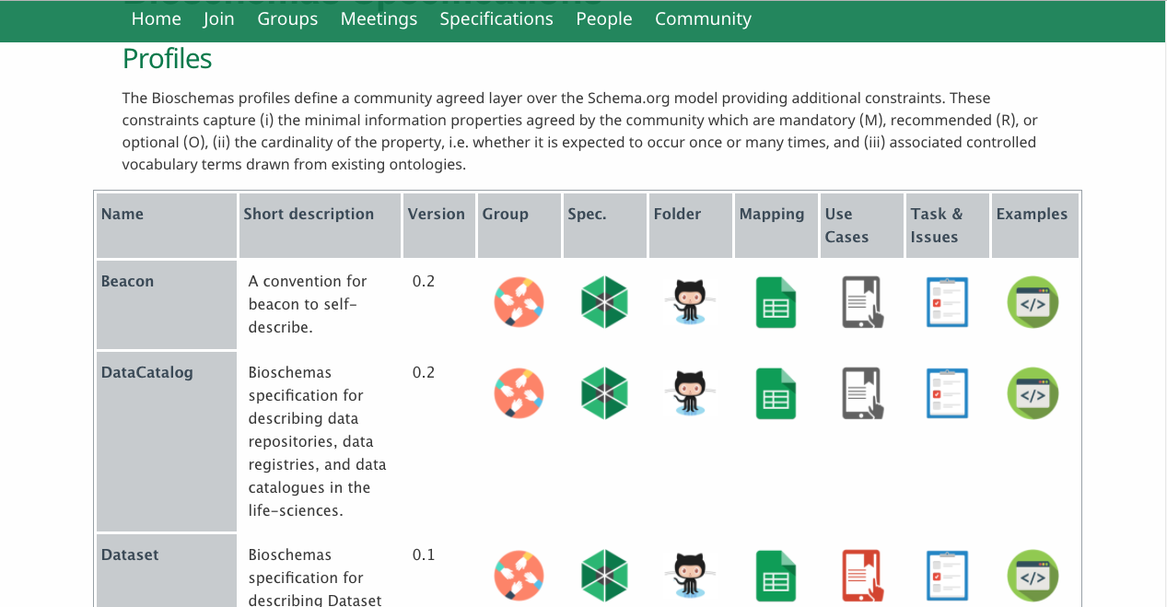



Manifest
schema.org tailored to the Biosciences
See Alasdair Gray’s Poster
13 public datasets marked up including Gigascience data journal
Training materials & Events
Laboratory protocols
Workflows and Tools
Notes:
DataCatalog and Datasets are relevant

Slide 34
Manifest Description: Profiles
Minimal FAIR
Manifest
Property | Description
[ro_id] | Persistent identifier of the RO.
[element_id] | Persistent identifier for each element inside the RO.
[ro_landingPage] | Landing page linked to the object identifier.
[manifest] | JSON-LD file where the information about the aggregation and its annotations is kept.
[citation] | Information for citation.
[credit] | Credit attribution explicit inside the RO.
[license] | Information about the license/s associated with the RO.
[version] | Information about the version or variant of the RO in use, or its elements.
[dependency_of] | Dependency of the element X inside the RO.
All elements of the RO must be available.
Notes:
Mandatory

Slide 35
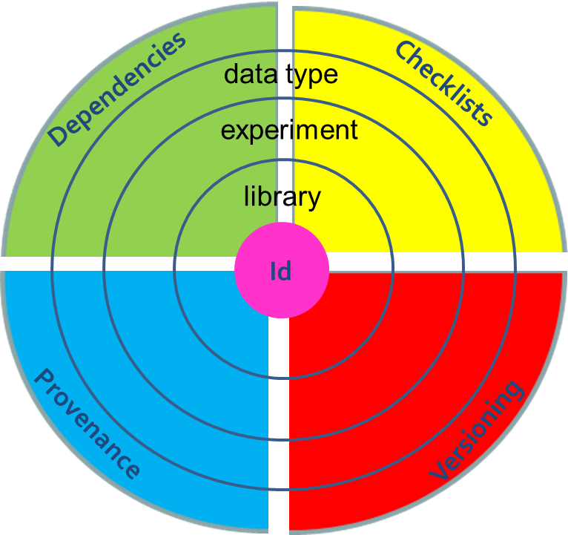
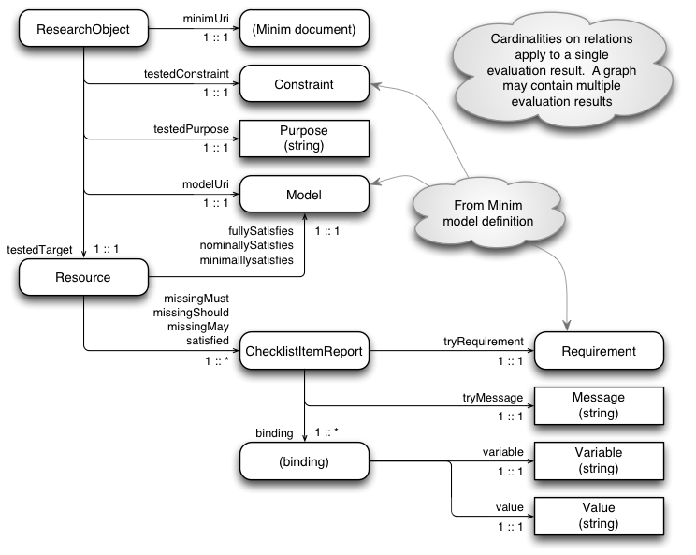
Manifest Description: Profiles
Manifest
Minim model for defining checklists
Common properties
among content types
http://purl.org/minim/description
Minimum information
for one content type
Gamble, Zhao, Klyne, Goble. "MIM: A Minimum Information Model Vocabulary and Framework for Scientific Linked Data", IEEE eScience 2012 Chicago, USA October, 2012), http://dx.doi.org/10.1109/eScience.2012.6404489
Notes:
Revise
Citation
Library
Experiment
Bio specific

Slide 36

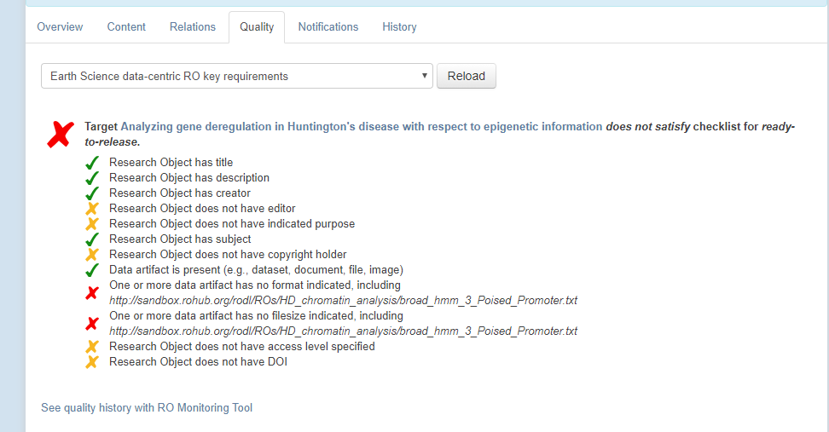
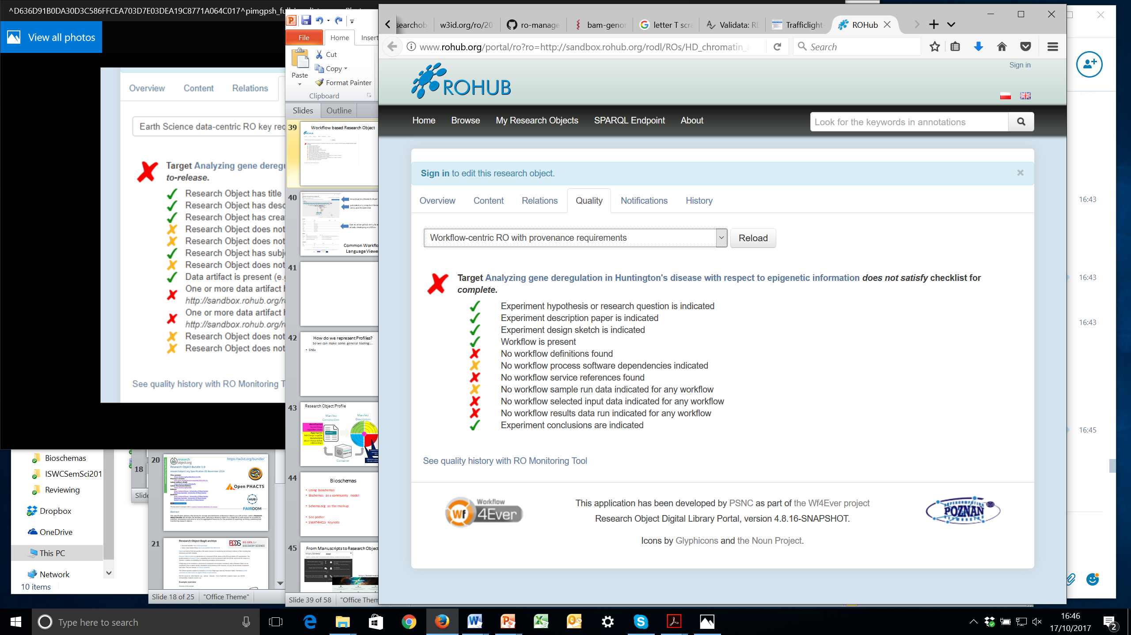
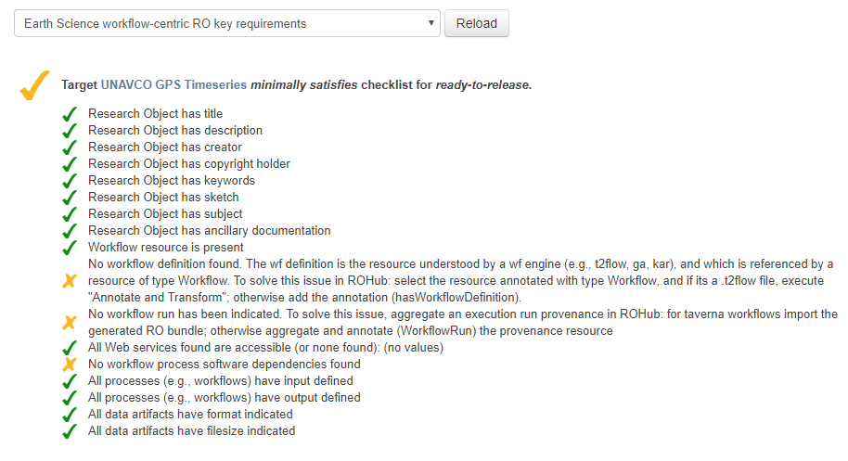
Validation and Monitoring Tools rich RDF-based generated from the workflow systems
Bespoke tooling, SPIN-based checking
Notes:
ShEx doesn’t do linking
http://www.rohub.org/portal/ro?ro=http://sandbox.rohub.org/rodl/ROs/IPWV_Iceland/ no entries
Its like a myExperiment Pack
but with a checker
http://www.rohub.org/portal/ro?ro=http://sandbox.rohub.org/rodl/ROs/HD_chromatin_analysis/

Slide 37

How can we express the Syntax and Semantics of Profiles to make generic tools?
Use RDF shapes (SHACL, ShEx) to capture requirements & consumer expectations
Validate profile using a ShEx schema and off-the-shelf validators (e.g. Validata)
Different levels:
from
Whole studies to
Complex types
Manifest construction
Check cross-reference constraints on identifiers
Check URI patterns, e.g. “starts with /”
Check JSON Structure
Notes:
Use with JSON schema
They are separate approaches.
ShEx is a pattern language with its own syntax that looks kind of like SPARQL. SHACL on the other hand is expressed as rules in RDF, and is more similar to declarative languages like XSLT and Prolog as it has a fixed traversal pattern (which can be used to instance to build XML or JSON while it trundles along)
Shape Expressions (ShEx) language describes RDF graph structures. These descriptions identify predicates and their associated cardinalities and datatypes. ShEx shapes can be used to communicate data structures associated with some process or interface, generate or validate data, or drive user interfaces. It is intended to:
validate RDF documents.
communicate expected graph patterns for interfaces.
generate user interface forms and interface code.
SHACL Shapes Constraint Language, a language for validating RDF graphs against a set of conditions. These conditions are provided as shapes and other constructs expressed in the form of an RDF graph. RDF graphs that are used in this manner are called "shapes graphs" in SHACL and the RDF graphs that are validated against a shapes graph are called "data graphs". As SHACL shape graphs are used to validate that data graphs satisfy a set of conditions they can also be viewed as a description of the data graphs that do satisfy these conditions. Such descriptions may be used for a variety of purposes beside validation, including user interface building, code generation and data integration.

Slide 38















https://doi.org/10.1109/BigData.2016.7840618
identifiers.org
JSON
manifest.json
The manifest ties everything together.
PROV
Notes:
Now while the BCO references these resources in several places in its JSON structure, some may also be indirectly referenced. For instance the CWL workflow might reference particular Docker images that capture the Python version to use.
W3C PROV files might be provided, which can explain more detailed provenance of workflows; this might however become specific to the workflow engine used, and might not be directly identified all the resources seen in the BCO.
While we can identify authors with ORCID, they might author different parts of the BCO. If you made a clever Python script used by a BCO, then it is only FAIR that you should be attributed – even if you were nowhere in the vicinity when the BCO was later created. So you can think of these pink, green and blue arrows here as each giving partial picture of what is the whole BioCompute Objects.
There is also the question of how to move the BCO around – the JSON has many external references as well as relative references to plain files – how can you capture it all without understanding all of the BCO spec?
We are looking at using the BagIt Research Objects for this purpose.
Bag-It is a digital archive format used by Library of Congress and digital repositories. It handles checksums and completeness of files, even if they are large or external.
Research Object (RO) is a model for capturing and describing research outputs; embedding data, executables, publications, metadata, provenance and annotations. Although it is a general model, ROs have been used in particular for capturing reproducible workflows.
The combination of these, ro-bagit has recently used by the NIH-funded Big Data for Discovery Service for transferring and archiving very large HTS datasets in a location-independent way, so naturally this could be a good choice for how to archive BCOs.
So here the manifest of the Research Object, ties everything together.
The manifest is in JSON-LD format – so it is Linked Data – but you don’t have to know unless you really want to – it is also just JSON.
The manifest **aggregates** all the other resources, including the BCO, but also external resources as well as outside references like identifiers.org.
The aggregation also provide attribution and provenance of each resource, so they get the credit they deserve. This is of course also important for regulatory purposes, e.g. to check if the latest version of a tool was used.
An important aspect of research objects is also to capture annotations, using the W3C Web Annotation Model. This allows any part of the BCO to be further described; textually or semantically; so you are not limited to what is supported by the specification of BCO or Research Object. In particular this might be where community-driven standards like BioSchemas can be used.

Slide 39
























Case study: Back to Workflows
Tool description
EDAM Ontology
SWO Ontology
Data Formats
Bioschemas.org
Workflow description
Richly described
Multi tiered descriptions
Lots of files
CWL in RDF….
CWL vocabulary for workflow structure matches 1:1 with YAML
schema.org annotations
Community led standard way of expressing and running workflows and the command line tools they orchestrate
Supports containers for portability
Based on wf4ever wfdesc

Slide 40

Common Workflow Language Viewer
Download as a Research Object Bundle
permalink to snapshot the GitHub entry and RO identifier
Over an active github entry for an actively developing workflow
CWL files packaged in a RO
CWL RO + added richness
Lift out parts into the manifest
Notes:
it would be the same wherever the git commit lives. So the links can also be generated locally with a git checkout - e.g. as we're doing in the cwltool reference runner provenance when we need to refer to what workflow was run
solved the problem we had in Taverna where we didn't know where the workflow lived
we still might not know that.. but if it's a public workflow and it later is visualized, then CWL Viewer can show it
future-proof!

Slide 41

Best Practices
In order to ensure that your workflow is well presented in CWL Viewer, we recommend the following of CWL Best Practices. Those which are specifically relevant to the viewer are detailed below, but it is suggested that you try to meet as many as possible to include the general quality and reproducibility of your workflows.
Some limitations of the CWL Viewer which you may need to be aware of are also described here.
Label Strings
Include a top level short label summarising each tool and workflow
Labels give the user an easy human-readable version of the name for the tool or workflow
For workflows this will be displayed at the top of the page as the title and for tools it will be displayed in the table and as the name of the step in the visualisation. If a label is given at the step level, it will take priority over the top level tool label. You can use this to provide a more descriptive label of the tool's application in the particular step if preferred.
Doc Strings
If useful, include a top level doc string providing a longer, more detailed description than was provided in the label (see above)
Docs give the user a detailed description of the role a tool or workflow performs
For workflows this will be displayed at the top of the page under the title and for tools it will be displayed in the table. If a doc string is given at the step level, it will take priority over the top level tool doc. You can use this to provide a more descriptive label of the tool's application in the particular step if preferred
Conceptual Identifiers
All input and output identifiers should reflect their conceptual identity. Generic and uninformative names such as result or input/output should be avoided
Helpful identifiers allow for the links between steps in the CWL file to be easily distinguished
Identifiers are displayed in the tables and are unique to the step. The label is also used as a replacement for the identifier in the visualisation if provided.
Format Specification
The format field should be specified for all input and output Files
Tools should use format identifiers from a relevant ontology such as the EDAM Ontology in the case of Bioinformatics tools. For plain types use the IANA media type list with$namespaces: { iana: "https://www.iana.org/assignments/media-types/" }, for example iana:text/plain, iana:text/tab-separated-values
The use of formal standards for format fields enables implementations to provide checks for compatibility in formatting of files
Ontologies will be parsed and the name of and link to the format displayed in the table on workflow pages. Plain formats will have the iana.org link given but will not display the name of the format.
Separation of Concerns
Each CommandLineTool description should focus on a single operation only, even if the (sub)command is capable of more.
This allows for easier reuse of the tool in other workflows and understanding as to it's purpose
In CWL Viewer this ensures that steps are clear in purpose within the workflow and generated visualisation
https://view.commonwl.org/about
Capturing Common Workflow Language Profile as ShEx
:shouldHaveLabel {
( a cwl:Workflow | a cwl:Tool );
rdfs:label LITERAL
}
:shouldHaveDoc {
( a cwl:Workflow | a cwl:Tool );
rdfs:comment LITERAL
}
:step {
a cwl:Step ;
cwl:inputs @:shouldHaveFormat ;
cwl:outputs @:shouldHaveFormat
}
:shouldHaveFormat {
cwl:File ;
dct:format ( @:iana | @:edam )
}
:iana IRI
/^https:\/\/www\.iana\.org\/assignments\/media-types\/.*
}
:edam IRI
/^https:\/\/edamontology\.org\/format_.*
rdfs:subClassOf <http://edamontology.org/format_1915>
}

Slide 42
ShEx is SPO testing not Graph Link Following
Info for Constraints are:
Embedded in a specific format
Extract/convert from domain-specific formats
Embedded in annotation resources
Use existing schema.org annotations
Need to be acquired
e.g. URI look-ups (ORCID -> author name)
Custom & hardcoded namespaces
Pre-declare ontologies
Add derived annotations post-processing
RDF must already be in a single graph
Can’t check if resource exists (e.g. 404)
Can’t test format/representation of resource (“is it actually an Excel file?”)
Can’t apply nested RDF shapes to Linked Data resources
Can’t say “Must be term from any resolvable ontology
Can’t check the format is actually in the EDAM ontology.
Notes:
Issues of ShEx
Should link follow
Implementation of validators
Can’t use off the shelf validators
Because we can’t iterate over whats in the RO

Slide 43

RDF Shape that indicates to follow links
RO pre-processing to merge to single graph
Bespoke validators / unpackers to iterate over the RO
Notes:
“if we can get it into a couple other impls, we could have it in shex 2.1”

Slide 44
Domain specific
“Must have a workflow that analyses next-gen sequencing data”
“Must be part of $fundedProject’s Investigation”
“All required data files must be provided”
“Generic names should be avoided”
General Tools that do their best at unpacking and handing off .
Notes:
Acquired
Look up URI (e.g. ORCID to author name)
Add manually in UI, saved as independent annotations
(Curator gets credit, does not touch other parts of RO)
Not in the RDF
Custom post-processing, extract/convert from domain-specific formats
Use existing schema.org annotations
Custom namespaces
Post-processing, adding derived annotations (e.g. SPARQL CREATE)
Acquired through e.g. URI look-ups
Look up URI (e.g. ORCID to author name)
Added through interfaces
Embedded in nested annotation resources
RDF Shape that indicates to follow links
RO pre-processing that merges to single graph

Slide 45



Slide 46











Did anyone take any notice?
Precision medicine
NGS pipelines regulation
ISI, USC
Metagenomics pipelines and LARGE datasets
Asthma Research e-Lab
sharing and computing statistical cohort studies
Standardised packing of Systems Biology models
U Rostock
Public Heath Learning Systems
Research Object Bundles for Data Releases
as if they were software
Dataset “build” tool
European Space Agency RO Library
Everest Project

Slide 47




Dnase Hypersensitivity Analysis keeping the context of data content together when its scattered transferring and archiving very large HTS datasets in a location-independent way,
Packaging format for encapsulating
Payload: arbitrary content
Tags: metadata describing the payload
Checksums: supports verification of content
5. Execute Big Data Analysis pipelines
1. Create a Query
BDDS Data
BDDS Analysis Services
2. Query
Encode to BDBag
Service
BDBAG
BDDS Galaxy
Service
3. Query
FASTQ
CEL
4. BD Bag MinID
6. Results
BDDS ERMRest
Service
BDDS Publication
Service
BDBAG
7. Publish Results
TRN
BDBag
8. Index Results
http://w3id.org/ro/bagit
https://doi.org/10.1109/BigData.2016.7840618
Notes:
for transferring and archiving very large HTS datasets in a location-independent way,

Slide 48



FAIRPORT, January 2014, Lorenz Centre, Leiden
Did anyone take any notice?
http://www.youtube.com/watch?v=p-W4iLjLTrQ&list=PLC44A300051D052E5
STM Innovations Seminar 2012
Howard Ratner, Chair STM
Future Labs Committee, CEO EVP Nature Publishing Group Director of Development for CHORUS (Clearinghouse for the Open Research of US)
Ted Slater
YARC, OpenBEL

Slide 49








A trend…. Using JSON(-LD) + schema.org
https://dokie.li/
https://linkedresearch.org/
BagIT data profile + schema.org JSON-LD annotations
Manifest: Schema.org, JSON-LD, RDF
Archive: .tar.gz
Reproducible Document Stack project
eLife, Substance and Stencila
Notes:
dataCrate – BagIt + Schema.org
CWL – complex types
https://github.com/UTS-eResearch/datacrate/blob/master/spec/0.1/data_crate_specification_v0.1.md
they just mentioned https://github.com/UTS-eResearch/datacrate/blob/master/spec/0.1/data_crate_specification_v0.1.md on the public-scholarly-html list - a kind of bagit data profile with some schema.org JSON-LD annotations -- a bit similar to our https://w3id.org/ro/bagit and obviously a clear trend
http://eresearch.uws.edu.au/blog/2013/11/01/introducing-next-years-model-the-data-crate-applied-standards-for-data-set-packaging/
https://github.com/ResearchObject/bagit-ro
Research Object BagIt archive
Document identifier: https://w3id.org/ro/bagit
Author: Stian Soiland-Reyes http://orcid.org/0000-0001-9842-9718
BagIt is an Internet Draft that specifies a file system structure for transferring and archiving a collection of files, including their checksums and brief metadata.
Research Object bundles is a specification for a structured ZIP-file, based on the ePub and Adobe UCF specifications. The bundle serializes a Research Object, embedding some or all of its resources within the ZIP file, and list the RO content in a manifest, in addition to embedding and referencing annotations and provenance.
A BagIt bag can be considered a mechanism for serialization and transport consistency, while a Research Object can be considered a way to capture identity, annotations and provenance of the resources. As such, the two formats complement each-other. They are however not directly compatible.
This GitHub repository explains by example a profile for a BagIt bag to also be a Research Object. Feel free to provide comments and raise issues, or suggest changes as pull requests.
https://nightly.science.ai/documentation/archive
Authoring platform
Reproducible Document Exchange Format – to present online, and preserve as publisher
An example published article, with enhanced reproducible version
Announcement: https://elifesciences.org/for-the-press/e6038800/elife-supports-development-of-open-technology-stack-for-publishing-reproducible-manuscripts-online
About the project: https://elifesciences.org/labs/7dbeb390/reproducible-document-stack-supporting-the-next-generation-research-article
June 2017 survey results: https://elifesciences.org/inside-elife/e832444e/innovation-understanding-the-demand-for-reproducible-research-articles

Slide 50


We should have called this “Research Objects”.
Don’t be too clever about your titles.
Combining ISA-based Research Objects with nanopublicatiions
Complementary approaches
Notes:
6427 views

Slide 51

Take-up Analogy: Start Ups
Platform & user buy-in from the get-go
Passionate, dedicated leadership
Community
Driver
Focus
Workflows
Reproducibility
Portability between
platforms
Seed funding
Standards
Tools
Easy to make
Hard to consume
Notes:
Specialist, bespoke
Rise of containers

Slide 52



Open Questions
Stewardship
owners, sites, authors
Spanning
platforms, researchers
Lifecycle
composition, forking….
Governance
Credit
micro-credit & citation propagation attribution
Tamper proofing
blockchain, ethereum
Maintenance
of evolving content
incrementality & degradation
Manifests
profile & template making
auto manufacture

Slide 53












Who gets credit for what?
Using Provenance for Credit Mapping
[Paolo Missier]
W3C PROV
dependency graph
“Provlets”
1
Bob
2
1
2
1
5
1
2
2
3
4
Alice
3
3
3
3
Granularity
Atomicity
Aggregation
Charlie
4
Paolo Missier, Data Trajectories: tracking reuse of published data for transitive credit attribution, IDCC 2016
Notes:
The convergence b/w transitive credit to data and SW:
credit to data requires provenance of the form "A used X and generated Y"
so when Y gets recognition, X gets part of the credit, mediated by A (the transformation)
but A is in fact a piece of SW which also belongs to someone
so when Y gets recognition, part of it should go to A's contributors in addition to X's contributors
internally, this credit to A may be distributed according to the dependency structure of A,
i.e. some if it will go to the contributors of the libs that are used in A, for example
so there is an external flow of credit from Y back to X through A
so this is a combined data/SW credit model,
and the portion that goes to A then originates a SW-only credit flow within A, that goes back to the dependencies used by A and gives credit to their contributors

Slide 54

Transitive Credit contribution
[Dan Katz and Arfon Smith]
Tracking RO usage and indirect contributions
Awarding fractional credit to contributors
1. “Contriponents”
contributors + components
2. Weighted contribution
3. Networked Credit maps
Travel with the contriponents
*Katz, D.S. & Smith, A.M., (2015). Transitive Credit and JSON-LD. Journal of Open Research Software. 3(1), p.e7, DOI: http://doi.org/10.5334/jors.by
D. S. Katz, "Transitive Credit as a Means to Address Social and Technological Concerns Stemming from Citation and Attribution of Digital Products," Journal of Open Research Software, v.2(1): e20, pp. 1-4, 2014. DOI: 10.5334/jors.be

Slide 55

researchobject.org
The Rhetoric of Research Objects
Manifests using semantics
Commons of components
A new scholarly currency
Necessity for reproducible machines
Foundation of release of research
Ramps rather than Revolution
Reports of the death of the scientific paper are greatly exaggerated

Slide 56







http://www.researchobject.org
http://www.wf4ever-project.org
http://www.fair-dom.org
http://seek4science.org
http://rightfield.org.uk
http://www.bioschemas.org
http://www.commonwl.org
http://www.bioexcel.eu
Mark Robinson
Alan Williams
Jo McEntyre
Norman Morrison
Stian Soiland-Reyes
Paul Groth
Tim Clark
Alejandra Gonzalez-Beltran
Philippe Rocca-Serra
Ian Cottam
Susanna Sansone
Kristian Garza
Daniel Garijo
Catarina Martins
Alasdair Gray
Rafael Jimenez
Iain Buchan
Caroline Jay
Michael Crusoe
Katy Wolstencroft
Barend Mons
Sean Bechhofer
Philip Bourne
Matthew Gamble
Raul Palma
Jun Zhao
Neil Chue Hong
Josh Sommer
Matthias Obst
Jacky Snoep
David Gavaghan
Rebecca Lawrence
Stuart Owen
Finn Bacall
Paolo Missier
Phil Crouch
Oscar Corcho
Dan Katz
Arfon Smith
All the members of the Wf4Ever team
Colleagues in Manchester’s Information Management Group,
ELIXIR-UK, Bioschemas

